Slide 1
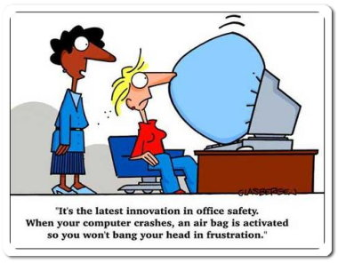
IT 467
Jianwei Lai
jlai12@ilstu.edu

Slide 2
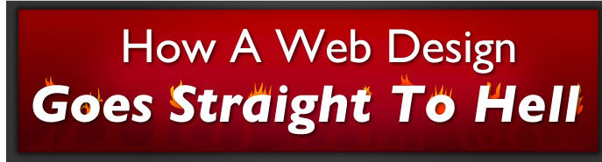
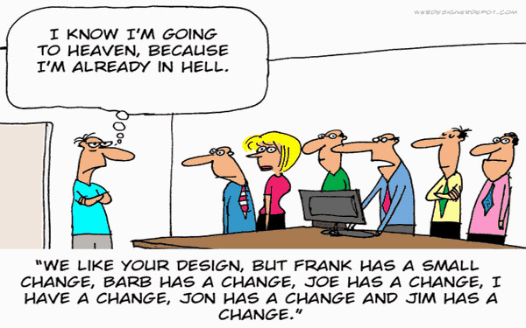
http://theoatmeal.com/comics/design_hell
Notes:
What were some of the issues with the oatmeal process?

Slide 3
Why?

Slide 4
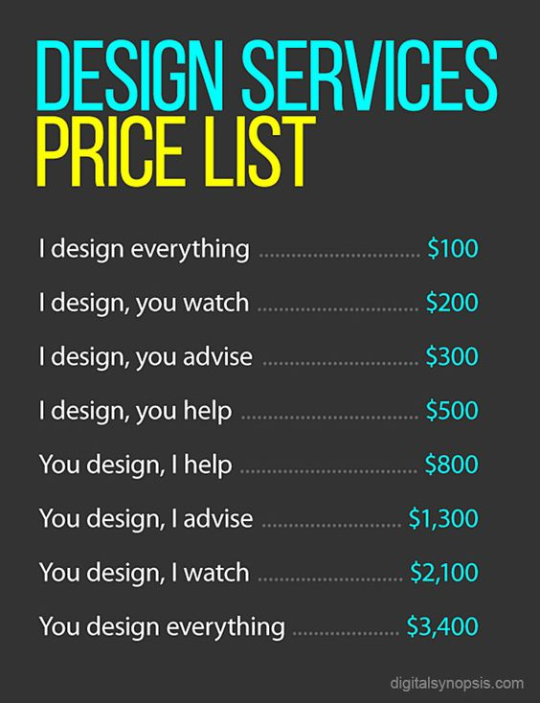

Slide 5
Less subjective – more objective
Human Factors – Usability – User Experience

Slide 6
Human Factors
U
S
a
b
i
lit
y
ergonomics
User Experience
Human
computer
interface

Slide 7
Human factors definition
In industry, human factors (also known as ergonomics) is the study of how humans behave physically and psychologically in relation to particular environments, products, or services.
http://searchsoa.techtarget.com/definition/human-factors

Slide 8
Human factors
the study of all the factors that make it easier to do the work in the right way
apply wherever humans work
also sometimes known as ergonomics
is employed to fulfill the goals of occupational health and safety and productivity
It is relevant in the design of such things as safe furniture and easy-to-use interfaces to machines and equipment.
Proper ergonomic design is necessary to prevent repetitive strain injuries and other musculoskeletal disorders, which can develop over time and can lead to long-term disability.
http://www.who.int/patientsafety/activities/technical/who_mc_topic-2.ppt

Slide 9
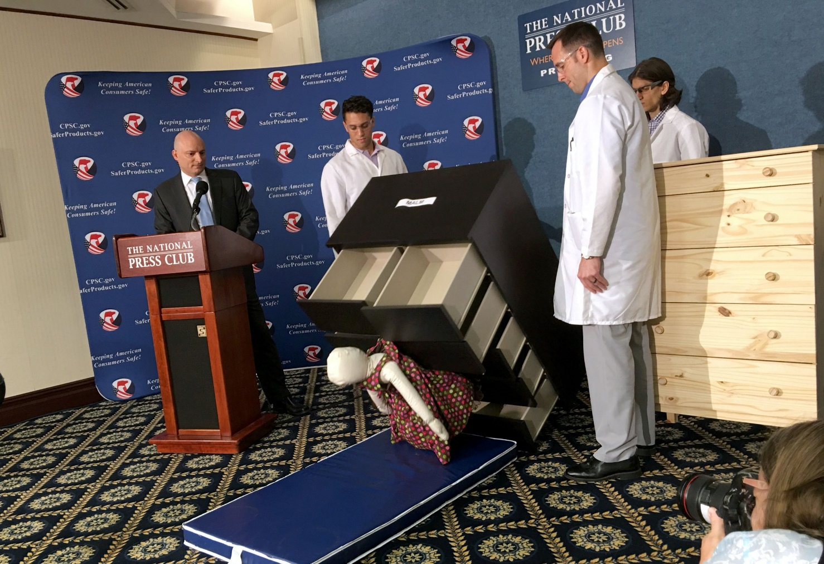
Ikea Dressers Kill Children
Ikea agrees to pay $46 million after tipped dresser kills toddler
https://www.newsweek.com/why-are-these-ikea-dressers-killing-children-718654
https://www.usatoday.com/story/news/investigations/2020/01/06/ikea-settles-46-million-after-dresser-kills-child/2821182001/

Slide 10
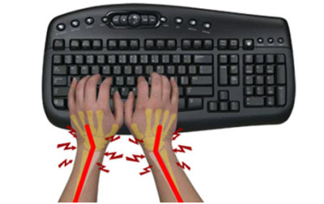
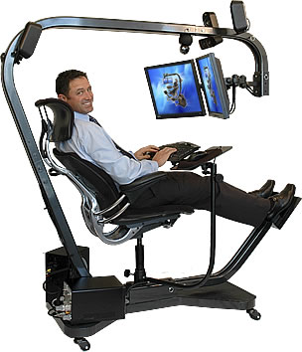
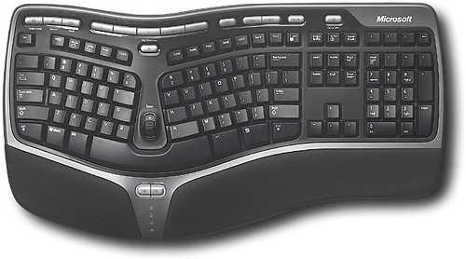
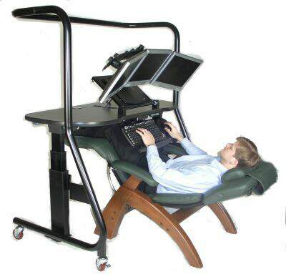
Ergonomic keyboard
Ergonomic computer chair

Slide 11
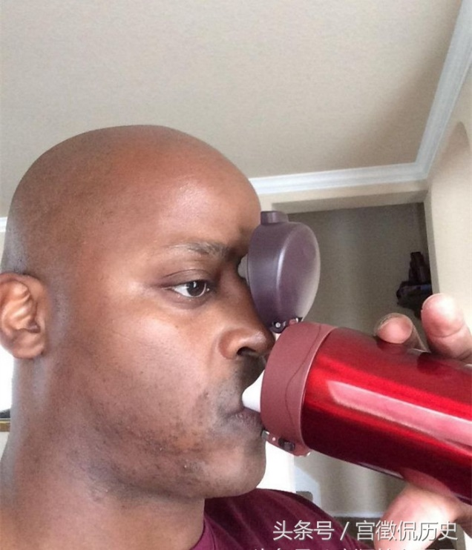
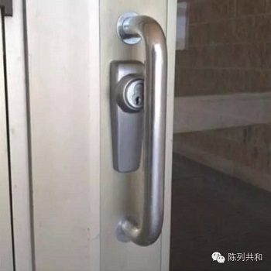
Anything you know is not so ergonomic?

Slide 12


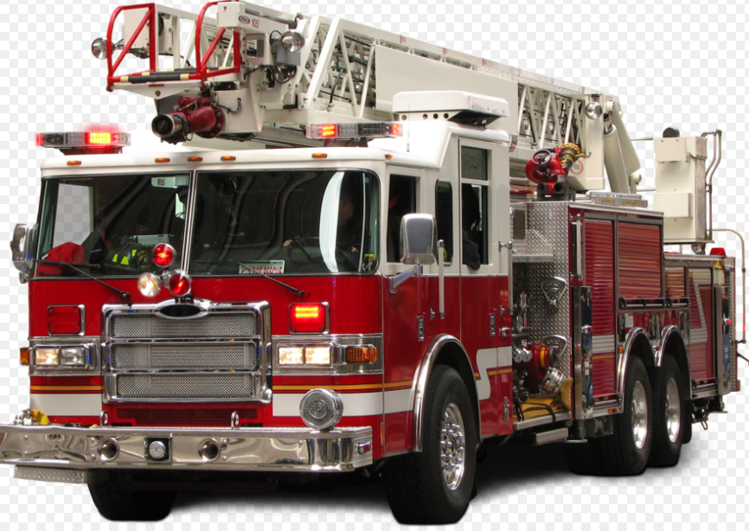
Which color is safer?
The color-transmitting cones in our eyes don't work well in the dark, some colors are easier for us to see at night. We are most sensitive to greenish-yellow colors under dim conditions, making lime shades easiest to see in low lighting.
http://www.apa.org/action/resources/research-in-action/lime.aspx

Slide 13


'World's ugliest colour' used on cigarette packets to put smokers off
Pantone 448 C, also known as ‘opaque couché’, is the shade chosen as most likely to put smokers off, a group of academics and market researchers decided after three months of research.
the color designed to repulse smokers
https://www.good.is/articles/olive-is-the-loneliest-color
https://www.independent.co.uk/news/world/australasia/worlds-ugliest-colour-revealed-pantone-448c-a7076446.html
Notes:
UK, Ireland and France

Slide 14
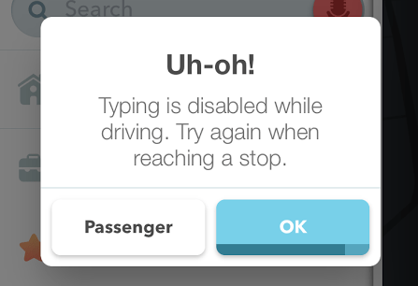
Waze promotes safe driving by suggesting that drivers do not use any typing features while a vehicle is in motion.
Notes:
https://www.jerecho.org/2015/11/18/is-using-your-phone-for-navigation-as-bad-as-texting/

Slide 15
Human beings make “silly” mistakes
Regardless of their experience, intelligence, motivation or vigilance, people make mistakes
Notes:
Detailed story + reason why.

Slide 16
One definition of “human error” is “human nature”
Error is the inevitable downside
of having a brain!

Slide 17
We can misperceive
situations despite the best of
intentions
It is one of the main reasons
that our decisions and actions can
be flawed

Slide 18
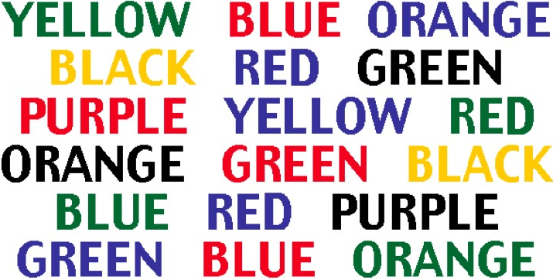
Look at the chart
Say the color of the word, not the word itself
Why is it hard?
Stroop effect
Optillusions.com
Notes:
Our brain wants to say the word - not the colour of the word.
Our brain tricks us.

Slide 19
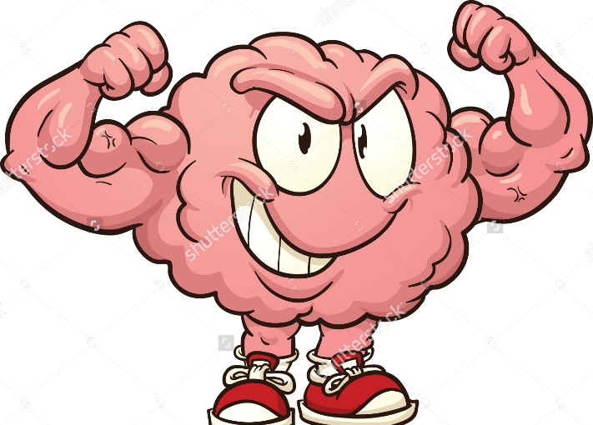
Sometimes though our brain is
“too clever” …
http://www.who.int/patientsafety/activities/technical/who_mc_topic-2.ppt

Slide 20
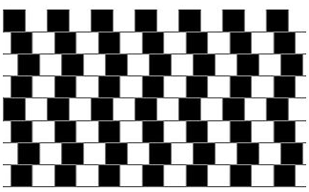
Are the lines crooked or straight?
Optillusions.com
Notes:
The lines are perfectly straight and parallel.
Why don’t they look straight?
Our brain is playing a trick on us - the way we perceive things isn’t always what’s going on (reality).

Slide 21
Individual factors that predispose to error
limited memory capacity
further reduced by:
fatigue
stress
hunger
illness
language or cultural factors
hazardous attitudes
Magic number 7± 2
4 2 8 9 4 0 2 5 8 3
384-723-0936

Slide 22
Stress and performance
Performance level
Area of “optimum” stress
Low stress Boredom
High stress Anxiety, panic
Stress level
The relationship between stress and performance
Yerkes, R. M., & Dodson, J. D. (1908) The relation of strength of stimulus to rapidity of habit-formation.
Journal of Comparative Neurology and Psychology, 18, 459-482
Notes:
The optimum level of performance is reached when the level of arousal is neither too high or too low.
Boredom is a problem if we are doing a highly automated and repetitive task, e.g. transcribing medication charts:
may be easy to commit a transcribing error

Slide 23
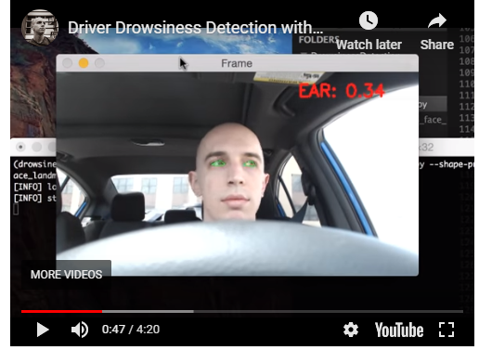
Drowsiness detection with OpenCV
https://www.pyimagesearch.com/2017/05/08/drowsiness-detection-opencv/

Slide 24
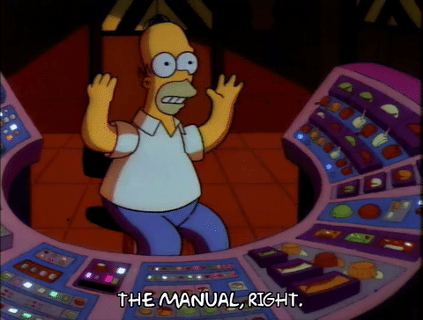
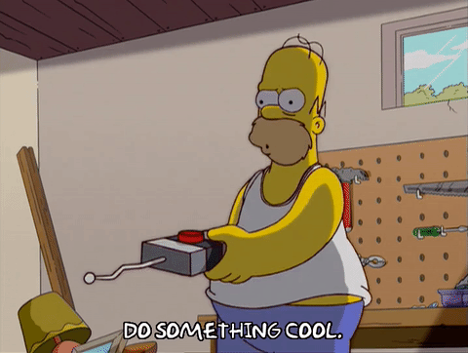

Slide 25
User Experience
ux

Slide 26
Definition of User Experience
“User experience” encompasses all aspects of the end-user’s interaction with the company, its services, and its products.”
by DON NORMAN and JAKOB NIELSEN
https://www.nngroup.com/articles/definition-user-experience/

Slide 27
User experience aspects
Desirable aspects
satisfying helpful fun
enjoyable motivating provocative
engaging challenging surprising
pleasurable enhancing sociability rewarding
exciting supporting creativity emotionally fulfilling
entertaining cognitively stimulating
Undesirable aspects
boring unpleasant
frustrating patronizing
making one feel guilty making one feel stupid
annoying cutesy
childish gimmicky
Notes:
27

Slide 28

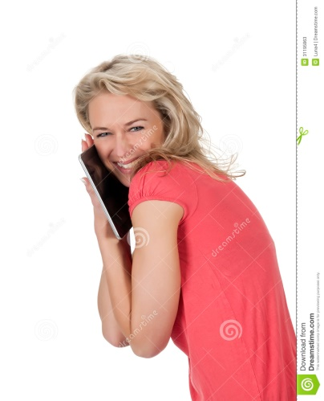
User Experience (UX)
UX = Usability ?
Usability: quality attribute of the UI
Easy to learn
Efficient to use
Pleasant to use
…
UX is an even broader concept
User experience is any aspect of a person's interaction with a given IT system, including the interface, graphics, industrial design, physical interaction, the manual, etc.
It includes their emotional, cognitive, social, cultural, and other psychological states.
The way people feel about a system and their pleasure and satisfaction when using it, looking at it, holding it, and opening or closing it.
Notes:
28

Slide 29
usability

Slide 30
Usability
Usability is a quality attribute that assesses how easy user interfaces are to use.
The word "usability" also refers to methods for improving ease-of-use during the design process.
Notes:
https://www.nngroup.com/articles/usability-101-introduction-to-usability/#:~:text=Usability%20is%20a%20quality%20attribute,defined%20by%205%20quality%20components%3A&text=Efficiency%3A%20Once%20users%20have%20learned,quickly%20can%20they%20perform%20tasks%3F

Slide 31
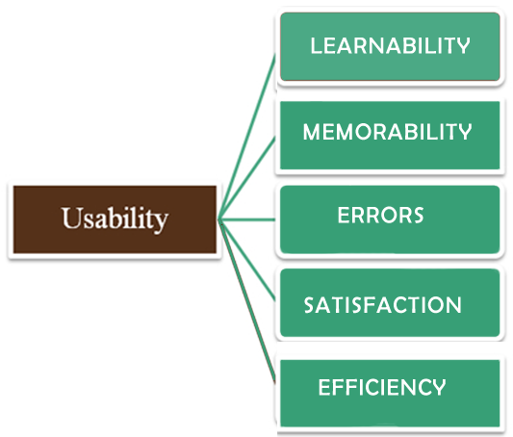
Usability is defined by 5 quality components
http://www.chrisdasie.com/myposts/5-components-of-usability
https://www.nngroup.com/articles/usability-101-introduction-to-usability/
Notes:
31

Slide 32
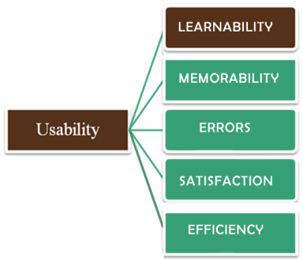
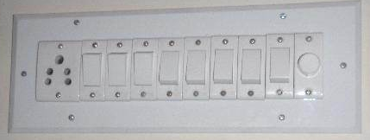
Learnability: How easy is it for users to accomplish basic tasks the first time they encounter the design?
https://www.youtube.com/watch?v=9WYGdstEVJQ

Slide 33
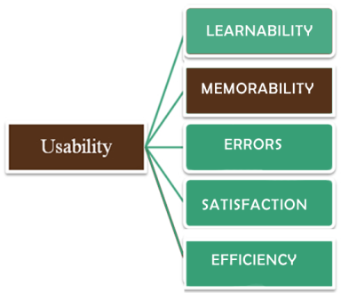
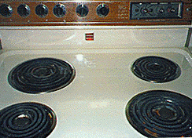
Memorability: When users return to the design after a period of not using it, how easily can they reestablish proficiency?

Slide 34
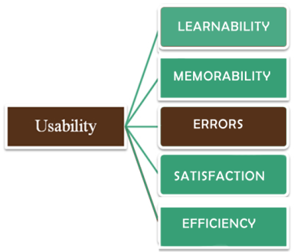
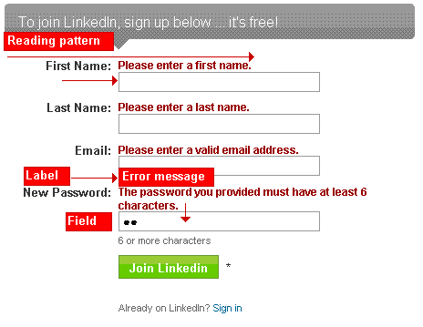
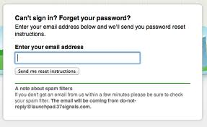
Errors: How many errors do users make, how severe are these errors, and how easily can they recover from the errors?

Slide 35
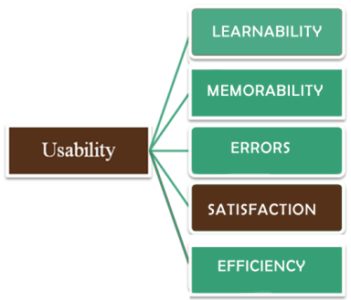
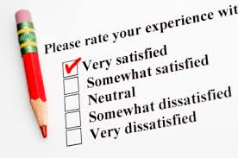
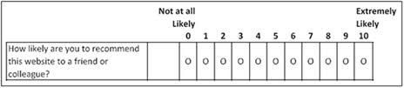
Satisfaction: How pleasant is it to use the design?

Slide 36
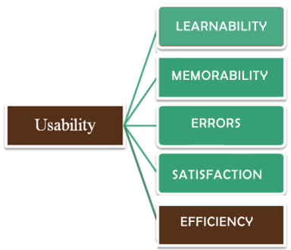
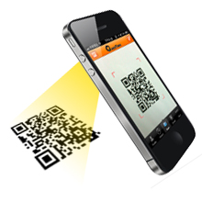
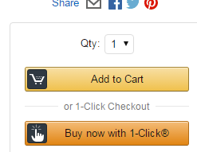
Efficiency: Once users have learned the design, how quickly can they perform tasks?

Slide 37
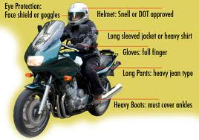

Question: What is an example of a making something more usable but creating a worse user experience?
A system set up for comfort/safety that is not as cool to use
Modifications that are harder to use but more fun
Notes:
37

Slide 38
Design principles

Slide 39
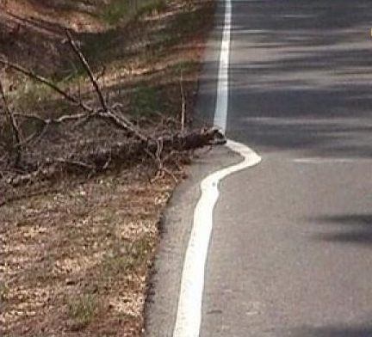
Design principles
Generalizable abstractions for thinking about different aspects of design
The do’s and don’ts of interaction design
What to provide and what not to provide at the interface
Derived from a mix of theory-based knowledge, experience and common-sense
Notes:
39

Slide 40
Design Principles:
Visibility
Feedback
Constraints
Consistency
Affordance (give a clue)
http://www.givegoodux.com/visibility-5-principles-interaction-design-supercharge-ui-2-5/#more-1459

Slide 41
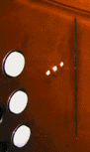
Visibility
• This is a control panel for an elevator
• How does it work?
• Push a button for the floor you want?
• Nothing happens. Push any other button? Still nothing. What do you need to do?
It is not visible as to what to do!
Notes:
41

Slide 42
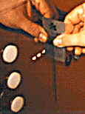
Visibility
…you need to insert your room card in the slot by the buttons to get the elevator to work!
How would you make this action more visible?
Make the card reader more obvious
provide an auditory message, that says what to do (which language?)
provide a big label next to the card reader that flashes when someone enters (what about sight impaired?)
make relevant parts visible
make what has to be done obvious
Not require it
Notes:
42

Slide 43
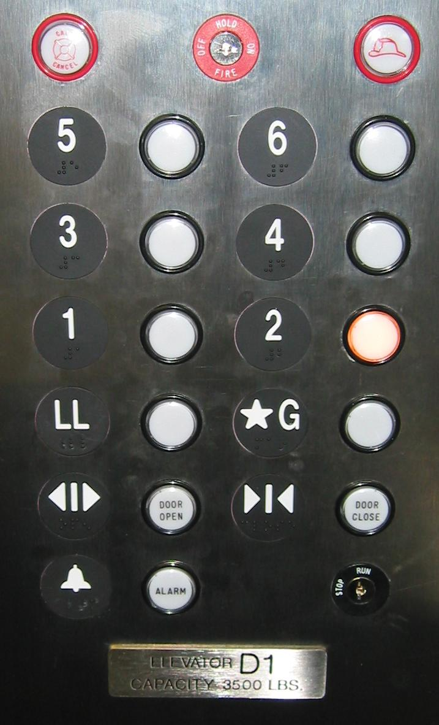
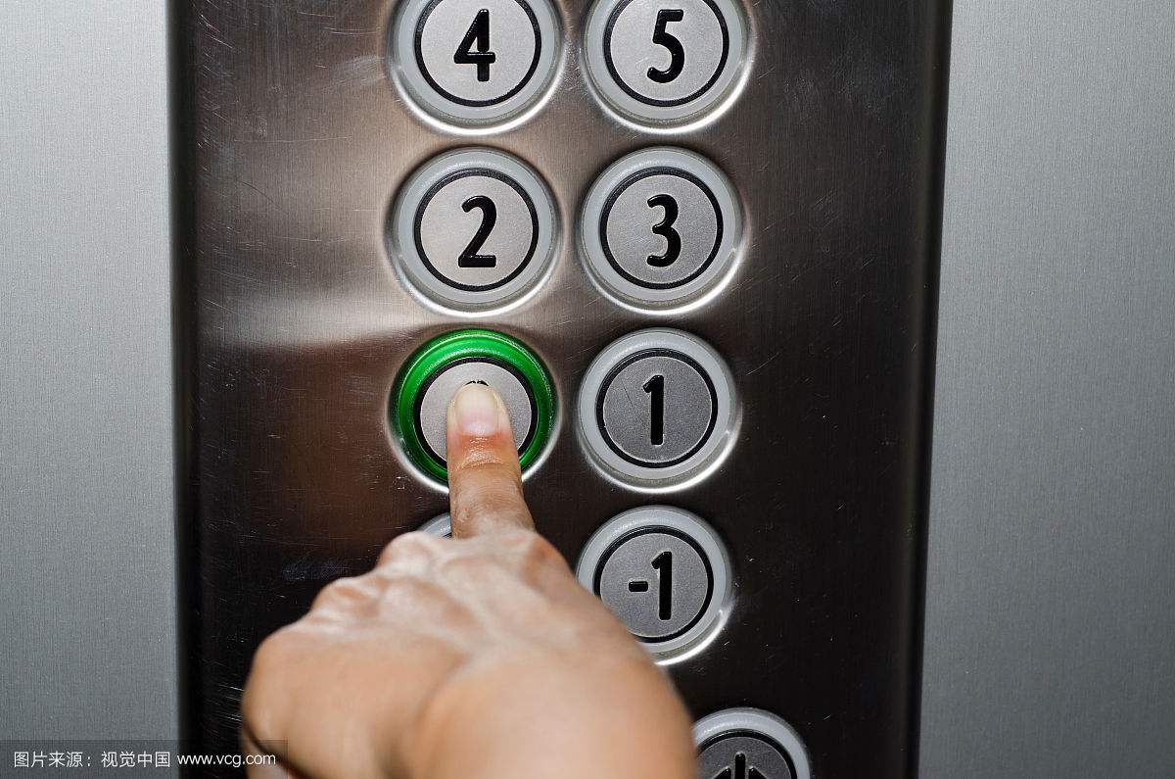

Slide 44
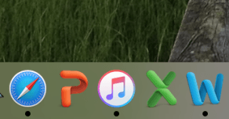
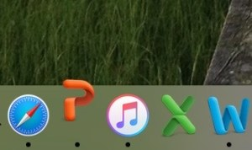
Anytime an application is open, the small gray dot appears below it in the doc.
when a user clicks on a closed application, the icon will bounce as it is opened.
http://sp16.cs179.org/2016/03/08/visibility-of-system-status-the-good-and-the-bad/

Slide 45
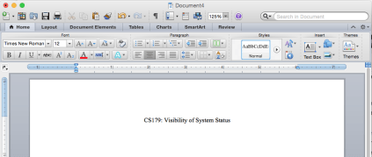
your work is unsaved

Slide 46
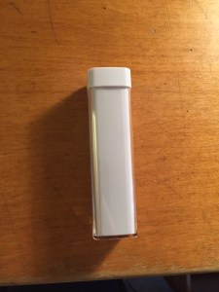
There is no way to tell whether or not the portable charger has been charged.
portable charger

Slide 47
Visibility
Invisible automatic controls can make it more difficult to use
What do I do if I am wearing black?
Notes:
47

Slide 48
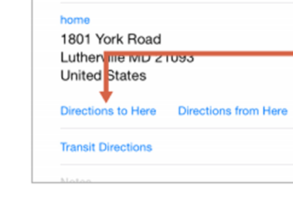
Common visibility mistakes
Link not indicated until you hover over it
You don’t know what can be found by clicking on a link until you click on and go to that page
Items needed for earlier decisions are hidden in an accordion menu
Items needed for earlier decisions are below the fold or off focus

Slide 49
Feedback
Feedback communicates the results of any interaction, making it visible and understandable.
Its job is to give the user a signal that they (or the product) have succeeded or failed at performing a task.
e.g. when screen button clicked on provides sound or red highlight feedback:
“ccclichhk”
Notes:
49

Slide 50
Feedback
Location: Where am I?
Current Status: What’s happening — and is it still happening?
Future Status: What will happen next?
Outcomes & Results: What just happened?

Slide 51
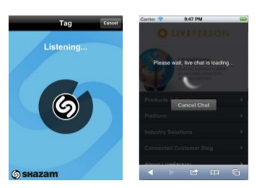
Common feedback mistake
Forgetting the confirmation page
Outlook sends emails without confirmation
No error message
Long page load time without a spinner (did I click on that link? Hmm…maybe I had better click it again.)

Slide 52
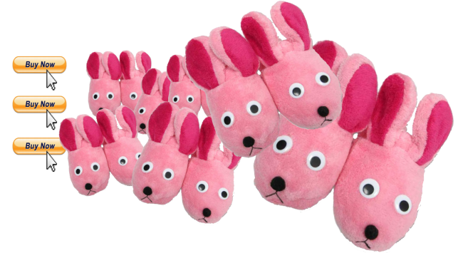
Failing to acknowledge an interaction can lead to unnecessary repetition of actions and errors or mistakes.
E.g., clicking the Buy Now button three times because nothing’s happening onscreen... and ordering waaaaay too many pairs of bunny slippers :-)

Slide 53
Constraints
Restricting the possible actions that can be performed
Helps prevent user from selecting incorrect options
Physical objects can be designed to constrain things
e.g. only one way you can insert a key into a lock
Notes:
53

Slide 54
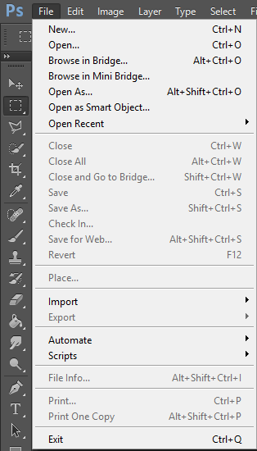
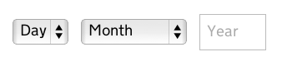
Constraint examples
← Greyed out items
Fields with only limited selections such as a birthday family

Slide 55
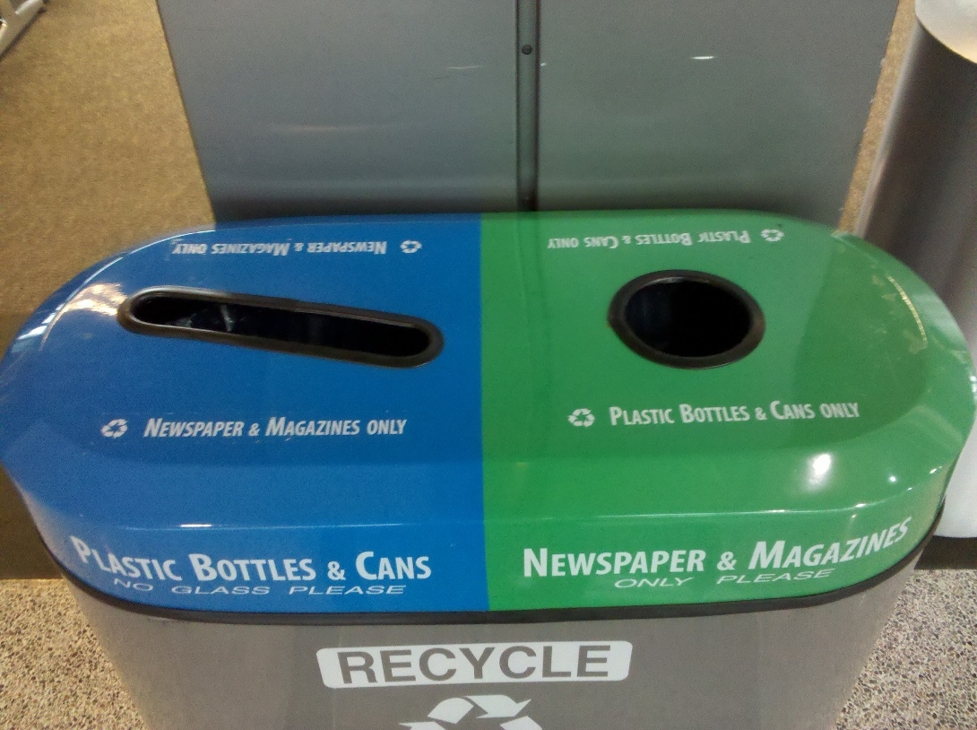
https://www.pinterest.com/uxfails/ux-fails/

Slide 56
Consistency
Design interfaces to have similar operations and use similar elements for similar tasks
For example:
always use ctrl key plus first initial of the command for an operation – ctrl+C, ctrl+S, ctrl+O
Main benefit is consistent interfaces are easier to learn and use
Notes:
56

Slide 57
Make the Interface Consistent
Consistency makes systems easier to use, because users don’t have to learn new things
If past interactive models have created user expectations, do not make changes unless there is a compelling reason to do so
Maintain consistency across a family of applications
Notes:
Consistency makes systems easier to use, because users don’t have to learn new things. MS office for example

Slide 58

Make the Interface Consistent

Slide 59
Make the Interface Consistent

Slide 60





Make the Interface Consistent
Search vs. Zoom

Slide 61


Shutdown a PC with Windows 7
Step 1: Go to the “Start” icon
Step 2: Click on “Shut down”

Slide 62


Challenge: Shutdown a PC with Windows 8
Task
Step 1: Move the cursor to the right
Step 2: Click on “Settings”
Notes:
First of all, please think about it “why user interface is important? Let’s do a task together to see how important user interface is. The task is simple enough: to shut down your PC. Here is the start screen of a computer with windows 8. And the cursor is in the lower-left corner (pointing with laser). To shut the computer down, we need first move the cursor to the right. Then, several icons will appear on the right side of the screen. One of them is “setting”. The second step is clicking on the setting icon.

Slide 63


Challenge: Shutdown a PC with Windows 8
Step 3: Click on “Power”
Step 4: Click on “Shutdown”
Notes:
After that several icons very show in the lower right corner of the screen (pointing with laser). The third step, is clicking on the “power” icon. Then a menu shows up. The fourth step is “clicking” the “shutdown” item of the menu.
Image it is your first time to use a window 8 computer. Is it easy for you to find out this four-step way to shut it down? I guess NO. because it is too complicated, and it is not efficient. If a interface is not easy to use, users will not like.

Slide 64
When consistency breaks down
What happens if there is more than one command starting with the same letter?
e.g. save, spelling, select, style, or cut, copy
Have to find other initials or combinations of keys, thereby breaking the consistency rule
e.g. ctrl+S, ctrl+Sp, ctrl+shift+L
Increases learning burden on user, making them more prone to errors
Notes:
64

Slide 65
Internal and external consistency
Internal consistency refers to designing operations to behave the same within an application
External consistency refers to designing operations, interfaces, etc., to be the same across applications and devices
Notes:
65

Slide 66

Maintain Consistency Across a Family of Applications
Consistent interfaces allow users to develop usage patterns of Microsoft Office
Notes:
The Microsoft Office user interface is consistent for a reason. Consistent interfaces allow users to develop usage patterns.
they’ll learn what the different buttons, tabs, icons and other interface elements look like and will recognize them and realize what they do in different contexts.

Slide 67
Keypad numbers layout
A case of external inconsistency
(a) phones, remote controls
(b) calculators, computer keypads
1
2
3
7
8
9
4
5
6
4
5
6
7
8
9
1
2
3
0
0
Notes:
67

Slide 68

Affordances: to give a clue
What are the visual clues that indicate that a button is, in fact, a button?
http://blog.teamtreehouse.com/affordances-web-design
Refers to an attribute of an object that allows people to know how to use it
e.g. a mouse button invites pushing, a door handle affords pulling
Notes:
68

Slide 69

Affordance

Slide 70

How would you fix this?

Slide 71

Midvale School for the Gifted

Slide 72


Slide 73

Bad Affordance

Slide 74

Why is this timer bad?
Need to turn anti-clock wise
Then clockwise to set time
No information provided
From: www.baddesigns.com
Notes:
74

Slide 75




Physical affordances
How do the following physical objects afford? Are they obvious?
Notes:
75

Slide 76


Slide 77
https://www.nngroup.com/articles/usability-101-introduction-to-usability/#:~:text=Usability%20is%20a%20quality%20attribute,defined%20by%205%20quality%20components%3A&text=Efficiency%3A%20Once%20users%20have%20learned,quickly%20can%20they%20perform%20tasks%3F
Something interesting to read
Usability 101: Introduction to Usability
The Magical Number 7 and UX
https://www.nngroup.com/videos/magical-number-7-ux/

